Slide 1


XYLO-BOT: A SOCIAL MUSIC PLATFORM FOR CHILDREN WITH AUTISM
Presenter: Howard Feng
Advisor: Dr. Mohammad H. Mahoor
Department: Electrical & Computer Engineering
University of Denver
5/13/2014

Slide 2
OUTLINE:
Social Behaviors
Autism Spectrum Disorders
Objectives of Our Study
Socially Assistive Robotics
Methodology: Protocol 1&2
Experimental Results
Contributions

Slide 3




Verbal Cues
Non-Verbal Cues
Facial expression
Utterance
Tone of Voice
Gaze Regulation
Body Language

Slide 4
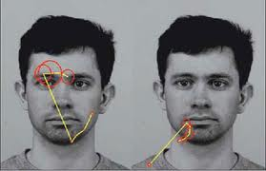
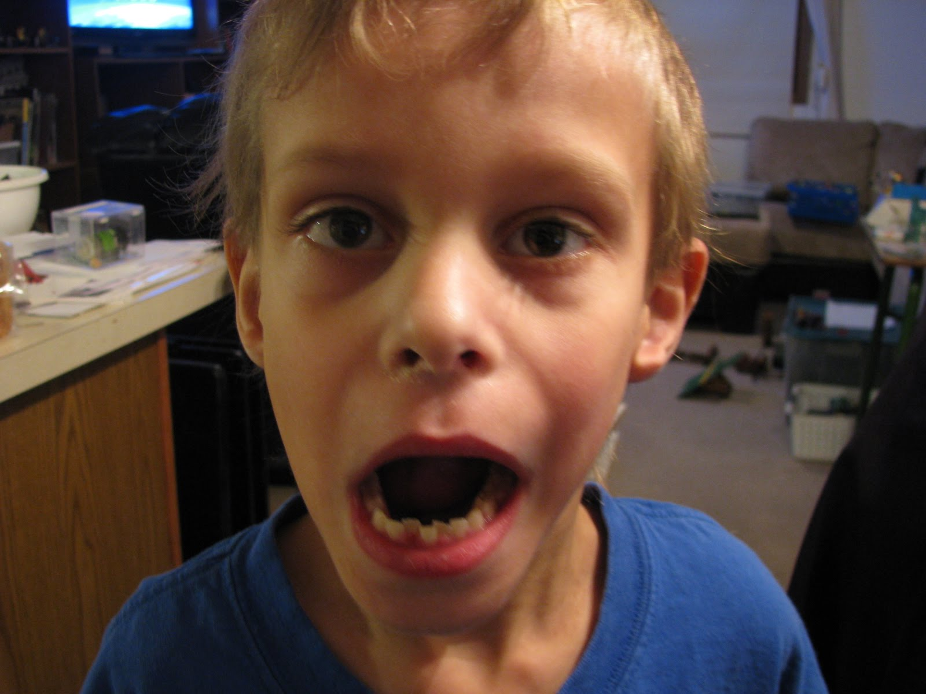
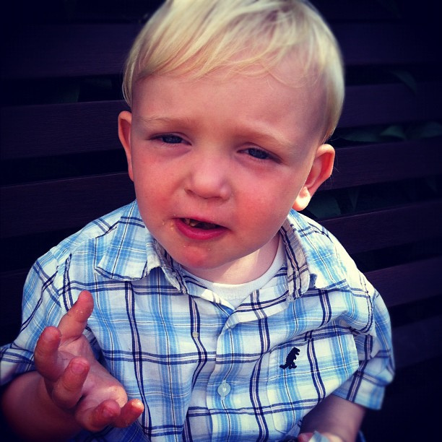
Deficits of ASD VS. Typically Developed Children (TD)
Difficulty in showing and recognizing Facial expression
Eye contact and Joint Attention Problems
Verbal Deficits
http://www.dana.org/Publications/Brainwork/Details.aspx
Notes:
Explain again this deficits of autism
Talk about in this two years how you feel about working with kids with asd
Why we need robot to do if for us.

Slide 5
Eye Gaze
Eye contact during conversation
Response
Comfortable
Joint attention
Notes:
This is the focused behavior in my study
Explain why eye gaze

Slide 6
Eye Gaze Patterns
Normal human has different eye gaze patterns while talking and listening
Speaker spent less than 50% of speaking time looking at listener
Listener spent more than 50% of listening time looking at speaker
M. Argyle, L. Lefebvre, M. Cook, The Meaning of Five Patterns of Gaze, European Journal of Social Psychology, Volume 4, Issue 2, pages 125–136, April/June 1974
Notes:
Mention that we will focus on this patterns to see what we can have from ASD and TD

Slide 7
Objective of This Study
Use robot to assist ASD children’s eye gaze regulation.
Utilized robot
Game design
Eye gaze contact measurement including fixation and shifting frequency
Eye gaze pattern modeling for TD and ASD
Temporal information: memorial or non-memorial
Under different contextual condition: listening or speaking

Slide 8
Why Robot?
Complex human-human interaction
ASD kids avert from human
More interest in mechanical objects and robots

Slide 9
Socially Assistive Robotics (SAR)
Objectives for using SARs
Defining socially assistive robotics
Assisting human with physical deficits
Provide social interaction
Tutoring
Different types of robots
Non-Humanoid Robot
Humanoid Robot
Notes:
Explain what is SAR in details

Slide 10
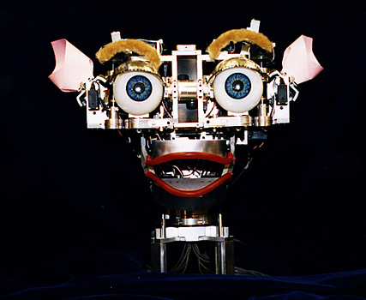
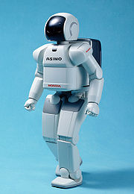
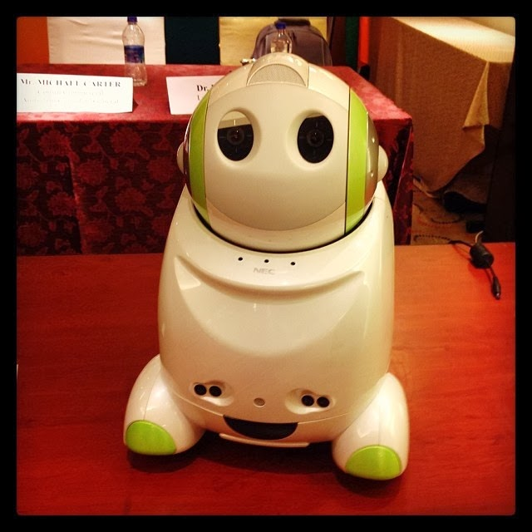
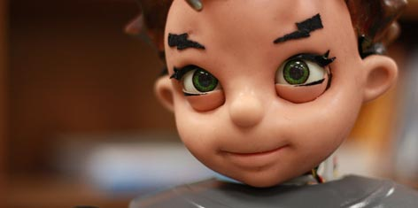
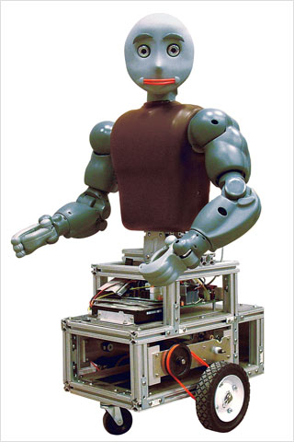
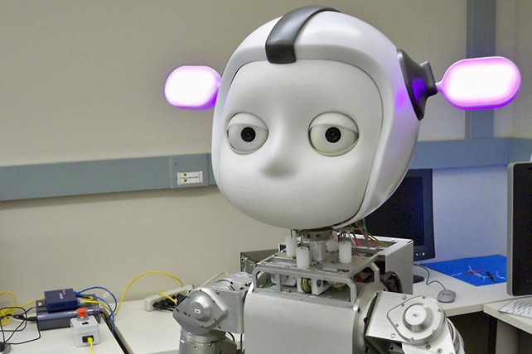

What is SAR?
ZENO
Kismet
Rosy
Bandit
ASIMO
Simon
Keepon
Notes:
Add name of these robots later

Slide 11
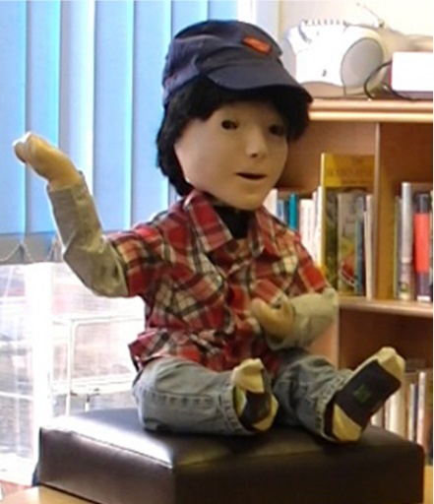


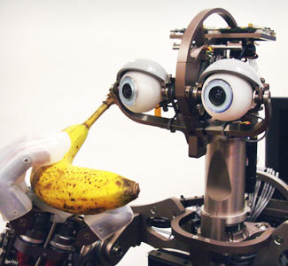
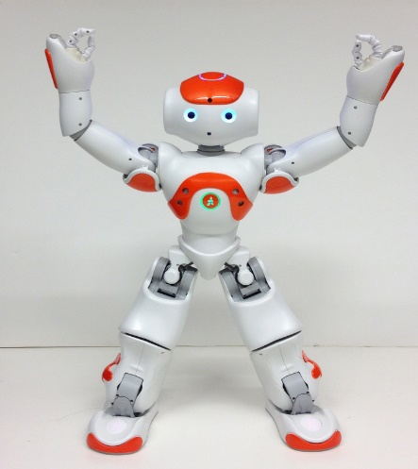

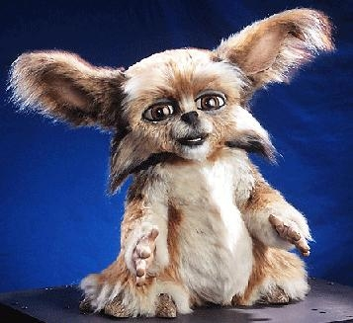

Social Robots
Humanoid Robots
Non-Humanoid Robots
Notes:
Describe pros and cons and why we choose NAO
Add names of them

Slide 12
Keepon
National Institute of information and Communications Technology,Japan
Non-Humanoid Robot
Four degree of freedom
CCD cameras in eyes
500 child-sessions
Gain skills: sharing, interaction
H. Kozima, C. Nakagawa, and Y. Yasuda. “Interactive robots for communication-care: a case-study in autism therapy.” Procs. IEEE Int. Symp. On Robot and Human Interactive Communication (ROMAN05), Nashville, USA, (2005)
Notes:
DOF talk about the movement it has
CCD talk about the eye contact facial tracking

Slide 13
KASPAR
University of Hertfordshire,Britan
Humanoid Robot
Facial Expressions
Contextual Feature
Gestures
B. Robins, K. Dautenhahn, and J. Dubowski, “Does appearance matter in the interaction of children with autism with a humanoid robot?” Interaction studies, vol.7, no. 3, pp. 479-512, 2006
Notes:
DOF talk about the movement it has
CCD talk about the eye contact facial tracking

Slide 14
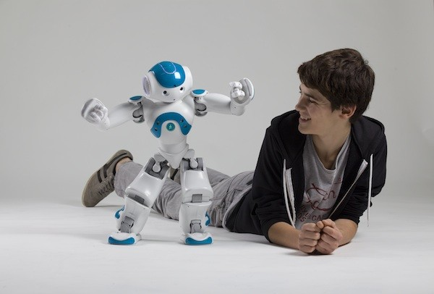
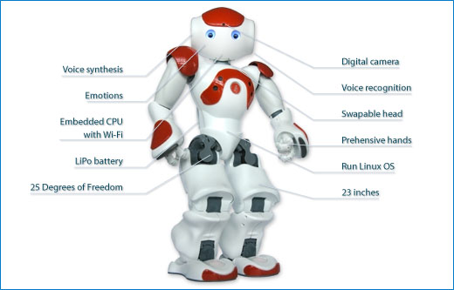
Why NAO?
NAO
Dance
Language
Eye contact
Recognition

